Slide 1
Apache Hadoop and Spark: Introduction and Use Cases for Data Analysis
Afzal Godil
Information Access Division, ITL, NIST

Slide 2
Outline
Growth of big datasets
Introduction to Apache Hadoop and Spark for developing applications
Components of Hadoop, HDFS, MapReduce and HBase
Capabilities of Spark and the differences from a typical MapReduce solution
Some Spark use cases for data analysis

Slide 3
Growth of Big Datasets
Internet/Online Data
  Clicks
  Searches
  Server requests
  Web logs
  Cell phone logs
  Mobile GPS locations
  User generated content
  Entertainment (YouTube, Netflix, Spotify, …)
Healthcare and Scientific Computations
  Genomics, medical images, healthcare data, billing data
Graph data
  Telecommunications network
  Social networks (Facebook, Twitter, LinkedIn, …)
  Computer networks
Internet of Things
  RFID
  Sensors
Financial data

Slide 4
Data
The Large Hadron Collider produces about 30 petabytes of data per year
Facebook’s data is growing at 8 petabytes per month
The New York stock exchange generates about 4 terabyte of data per day
YouTube had around 80 petabytes of storage in 2012
Internet Archive stores around 19 petabytes of data

Slide 5
Cloud and Distributed Computing
The second trend is pervasiveness of cloud based storage and computational resources
  For processing of these big datasets
Cloud characteristics
  Provide a scalable standard environment
  On-demand computing
  Pay as you need
  Dynamically scalable
  Cheaper

Slide 6
Data Processing and Machine learning Methods
Data processing (third trend)
  Traditional ETL (extract, transform, load)
  Data Stores (HBase, ……..)
  Tools for processing of streaming,
  multimedia & batch data
Machine Learning (fourth trend)
  Classification
  Regression
  Clustering
  Collaborative filtering
Data Processing ETL (extract, transform, load)
Big Datasets
Machine
Learning
Distributed Computing
Working at the Intersection of these four trends is very exciting and challenging and require new ways to store and process Big Data

Slide 7
Hadoop Ecosystem
Enable Scalability
  on commodity hardware
Handle Fault Tolerance
Can Handle a Variety of Data type
  Text, Graph, Streaming Data, Images,…
Shared Environment
Provides Value
  Cost

Slide 8
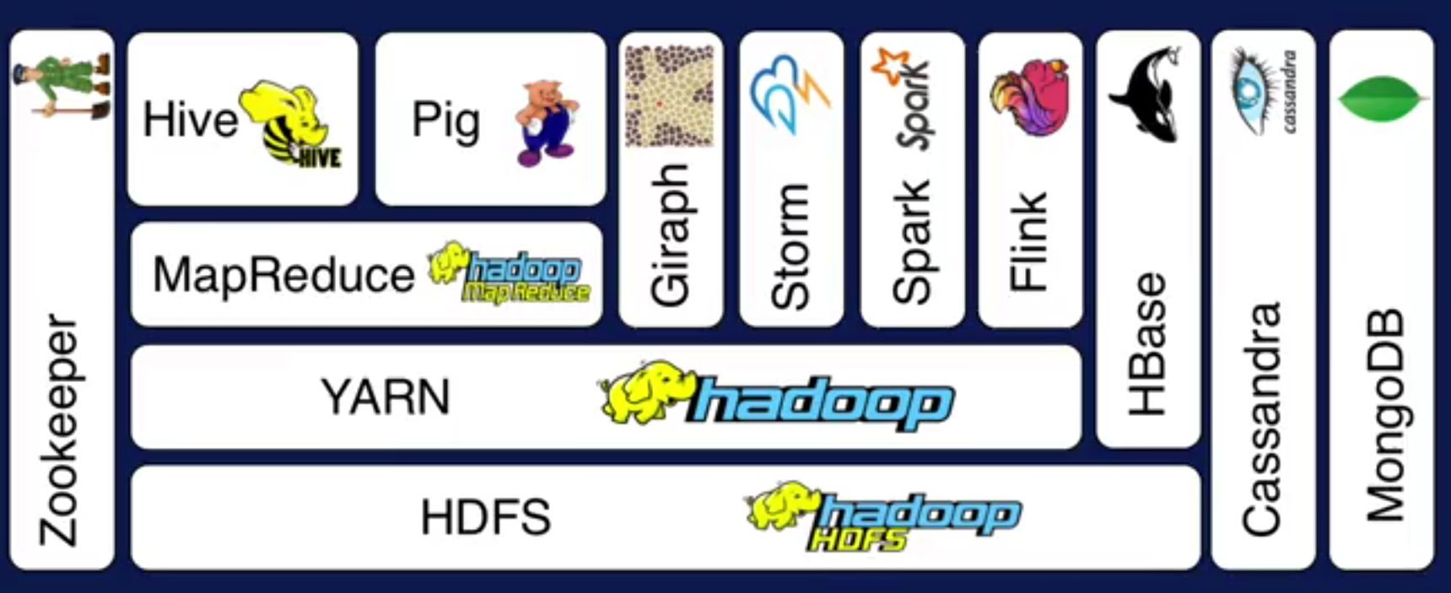
Hadoop Ecosystem
A
Layer Diagram
B
C
D

Slide 9
Apache Hadoop Basic Modules
Hadoop Common
Hadoop Distributed File System (HDFS)
Hadoop YARN
Hadoop MapReduce
Other Modules: Zookeeper, Impala, Oozie, etc.
Spark, Storm, Tez, etc.
HBase
Non-relational Database
Pig
Scripting
Hive
SQL Like Query
MapReduce
Distributed Processing
Others
Distributed Processing
Yarn
Resource Manager
HDFS Distributed File System (Storage)
Notes:
YARN is resource manager

Slide 10
Hadoop HDFS
Hadoop distributed File System (based on Google File System (GFS) paper, 2004)
  Serves as the distributed file system for most tools in the Hadoop ecosystem
  Scalability for large data sets
  Reliability to cope with hardware failures
HDFS good for:
  Large files
  Streaming data
Not good for:
  Lots of small files
  Random access to files
  Low latency access
Single Hadoop cluster with 5000 servers and 250 petabytes of data

Slide 11
Design of Hadoop Distributed File System (HDFS)
Master-Slave design
Master Node
  Single NameNode for managing metadata
Slave Nodes
  Multiple DataNodes for storing data
Other
  Secondary NameNode as a backup

Slide 12
HDFS Architecture
NameNode keeps the metadata, the name, location and directory
DataNode provide storage for blocks of data
Client
NameNode
Secondary NameNode
DataNode
DataNode
DataNode
DataNode
DataNode
DataNode
DataNode
DataNode
Heartbeat, Cmd, Data

Slide 13
HDFS
What happens; if node(s) fail?
Replication of Blocks for fault tolerance
File
B1
B2
B3
B4
Node
Node
Node
Node
B1
B2
B4
B3
Node
Node
Node
Node
B1
B3
B1
B2
B4
Node
Node
Node
Node
B4
B3
B1
B2

Slide 14
HDFS
HDFS files are divided into blocks
  It’s the basic unit of read/write
  Default size is 64MB, could be larger (128MB)
  Hence makes HDFS good for storing larger files
HDFS blocks are replicated multiple times
  One block stored at multiple location, also at different racks (usually 3 times)
  This makes HDFS storage fault tolerant and faster to read

Slide 15
Few HDFS Shell commands
Create a directory in HDFS
hadoop fs -mkdir /user/godil/dir1
List the content of a directory
hadoop fs -ls /user/godil
Upload and download a file in HDFS
hadoop fs -put /home/godil/file.txt /user/godil/datadir/
hadoop fs -get /user/godil/datadir/file.txt /home/
Look at the content of a file
Hadoop fs -cat /user/godil/datadir/book.txt
Many more commands, similar to Unix

Slide 16
HBase
NoSQL data store build on top of HDFS
Based on the Google BigTable paper (2006)
Can handle various types of data
Stores large amount of data (TB,PB)
Column-Oriented data store
Big Data with random read and writes
Horizontally scalable

Slide 17
HBase, not to use for
Not good as a traditional RDBMs (Relational Database Model)
  Transactional applications
  Data Analytics
Not efficient for text searching and processing

Slide 18
MapReduce: Simple Programming for Big Data
Based on Google’s MR paper (2004)
MapReduce is simple programming paradigm for the Hadoop ecosystem
Traditional parallel programming requires expertise of different computing/systems concepts
  examples: multithreads, synchronization mechanisms (locks, semaphores, and monitors )
  incorrect use: can crash your program, get incorrect results, or severely impact performance
  Usually not fault tolerant to hardware failure
The MapReduce programming model greatly simplifies running code in parallel
  you don't have to deal with any of above issues
  only need to create, map and reduce functions

Slide 19
Map Reduce Paradigm
Map and Reduce are based on functional programming
Apply function Map: Apply a function to all the elements of List list1=[1,2,3,4,5]; square x = x * x list2=Map square(list1) print list2 -> [1,4,9,16,25] | Reduce: Combine all the elements of list for a summary list1 = [1,2,3,4,5]; A = reduce (+) list1 Print A -> 15
Input
Map
Reduce
Output

Slide 20
MapReduce Word Count Example
I am Sam
Node
(I,1)
(am,1)
(Sam,1)
Node
File
Map
Reduce
B
E
B
A
Sam I am
Node
Shuffle
&
Sort
Node
C
Map
Reduce
D
A
F
(I,2)
(am,2)
(Sam,2)
(…,..)
(..,..)
………
Node
Node
Map
Reduce
C
G
(I,1)
(am,1)
(Sam,1)
………
Node
Node
Map
Reduce
D
H

Slide 21
Shortcoming of MapReduce
Forces your data processing into Map and Reduce
  Other workflows missing include join, filter, flatMap, groupByKey, union, intersection, …
Based on “Acyclic Data Flow” from Disk to Disk (HDFS)
Read and write to Disk before and after Map and Reduce (stateless machine)
  Not efficient for iterative tasks, i.e. Machine Learning
Only Java natively supported
  Support for others languages needed
Only for Batch processing
  Interactivity, streaming data

Slide 22
One Solution is Apache Spark
A new general framework, which solves many of the short comings of MapReduce
It capable of leveraging the Hadoop ecosystem, e.g. HDFS, YARN, HBase, S3, …
Has many other workflows, i.e. join, filter, flatMapdistinct, groupByKey, reduceByKey, sortByKey, collect, count, first…
  (around 30 efficient distributed operations)
In-memory caching of data (for iterative, graph, and machine learning algorithms, etc.)
Native Scala, Java, Python, and R support
Supports interactive shells for exploratory data analysis
Spark API is extremely simple to use
Developed at AMPLab UC Berkeley, now by Databricks.com

Slide 23
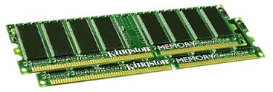
Spark Uses Memory instead of Disk
Hadoop: Use Disk for Data Sharing
HDFS
read
HDFS
Write
HDFS
read
HDFS
Write
Iteration1
Iteration2
Spark: In-Memory Data Sharing
HDFS read
Iteration1
Iteration2

Slide 24
Sort competition
 | Hadoop MR Record (2013) | Spark Record (2014)
Data Size | 102.5 TB | 100 TB
Elapsed Time | 72 mins | 23 mins
# Nodes | 2100 | 206
# Cores | 50400 physical | 6592 virtualized
Cluster disk throughput | 3150 GB/s (est.) | 618 GB/s
Network | dedicated data center, 10Gbps | virtualized (EC2) 10Gbps network
Sort rate | 1.42 TB/min | 4.27 TB/min
Sort rate/node | 0.67 GB/min | 20.7 GB/min
Spark, 3x faster with 1/10 the nodes
Sort benchmark, Daytona Gray: sort of 100 TB of data (1 trillion records)
http://databricks.com/blog/2014/11/05/spark-officially-sets-a-new-record-in-large-scale-sorting.html

Slide 25
Apache Spark
Apache Spark supports data analysis, machine learning, graphs, streaming data, etc. It can read/write from a range of data types and allows development in multiple languages.
Scala, Java, Python, R, SQL
DataFrames
ML Pipelines
Spark SQL
Spark Streaming
MLlib
GraphX
Spark Core
Data Sources
Hadoop HDFS, HBase, Hive, Apache S3, Streaming, JSON, MySQL, and HPC-style (GlusterFS, Lustre)

Slide 26
Resilient Distributed Datasets (RDDs)
RDDs (Resilient Distributed Datasets) is Data Containers
All the different processing components in Spark share the same abstraction called RDD
As applications share the RDD abstraction, you can mix different kind of transformations to create new RDDs
Created by parallelizing a collection or reading a file
Fault tolerant

Slide 27
DataFrames & SparkSQL
DataFrames (DFs) is one of the other distributed datasets organized in named columns
Similar to a relational database, Python Pandas Dataframe or R’s DataTables
  Immutable once constructed
  Track lineage
  Enable distributed computations
How to construct Dataframes
  Read from file(s)
  Transforming an existing DFs(Spark or Pandas)
  Parallelizing a python collection list
  Apply transformations and actions

Slide 28
DataFrame example
// Create a new DataFrame that contains “students”
students = users.filter(users.age < 21)
//Alternatively, using Pandas-like syntax
students = users[users.age < 21]
//Count the number of students users by gender
students.groupBy("gender").count()
// Join young students with another DataFrame called logs
students.join(logs, logs.userId == users.userId,
“left_outer")

Slide 29
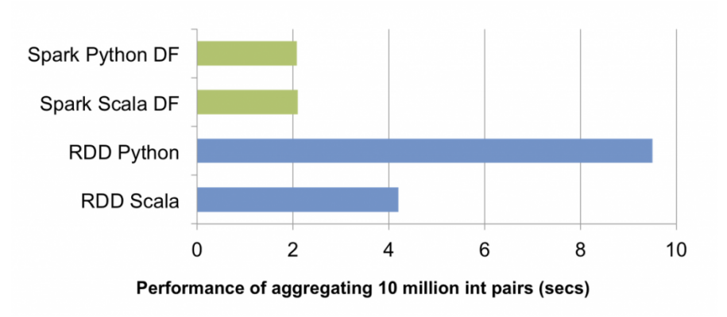
RDDs vs. DataFrames
RDDs provide a low level interface into Spark
DataFrames have a schema
DataFrames are cached and optimized by Spark
DataFrames are built on top of the RDDs and the core Spark API
Example: performance

Slide 30
Spark Operations
Transformations (create a new RDD) | map filter sample groupByKey reduceByKey sortByKey intersection | flatMap union join cogroup cross mapValues reduceByKey
Actions (return results to driver program) | collect first Reduce take Count takeOrdered takeSample countByKey take save lookupKey foreach

Slide 31
Directed Acyclic Graphs (DAG)
B
C
A
E
S
D
F
DAGs track dependencies (also known as Lineage )
nodes are RDDs
arrows are Transformations

Slide 32
Lazy evaluation (extra slide)
The standard (or busy) way to do this is
Calculate the square of each element.
Sum the squares.
==> This requires storing all intermediate results.
An alternative is lazy evaluation:
postpone computing the square until result is needed.
No need to store intermediate results.
Scan through the data once, rather than twice.
Notes:
Trao đổi về Kmeans và Lazy evaluation trong Spark
https://techmaster.vn/posts/36242/apache-spark-fundamentals-phan-2-spark-core-va-rdd#:~:text=ghi%20c%E1%BB%A7a%20RDD-,Lazy%20evaluation,%C4%91%E1%BB%83%20tr%E1%BA%A3%20ra%20k%E1%BA%BFt%20qu%E1%BA%A3.
https://cloudxlab.com/assessment/displayslide/385/apache-spark-lazy-evaluation-lineage-graph
https://www.projectpro.io/recipes/explain-spark-lazy-evaluation-detail
https://mas-dse.github.io/DSE230/decks/5.%20Execution%20plans,%20Lazy%20Evaluation,%20and%20caching.slides.html

Slide 33

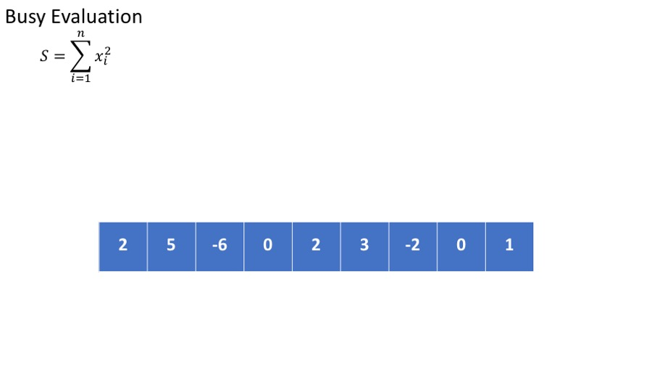
Example
Calculate

Slide 34
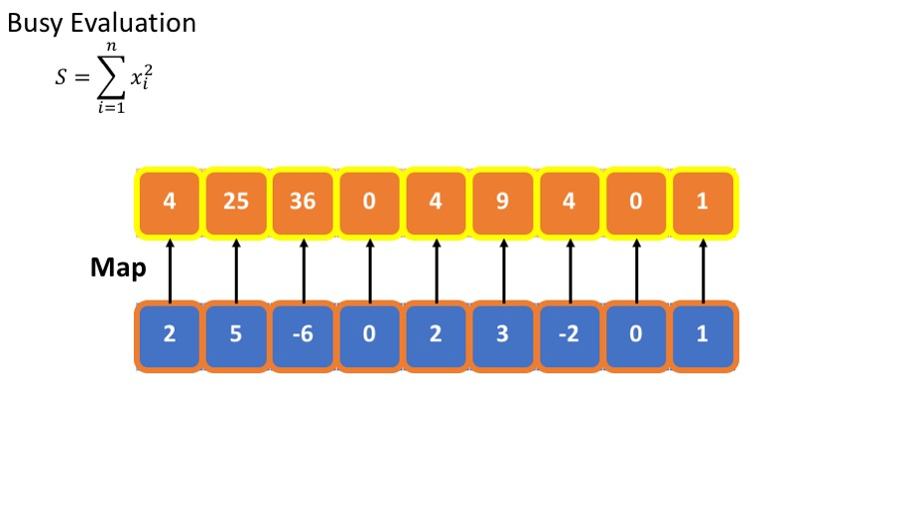
Example
Calculate

Slide 35
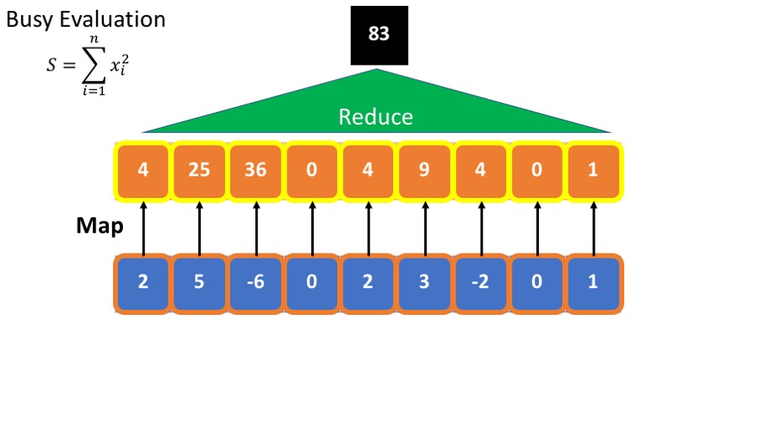
Example
Calculate

Slide 36
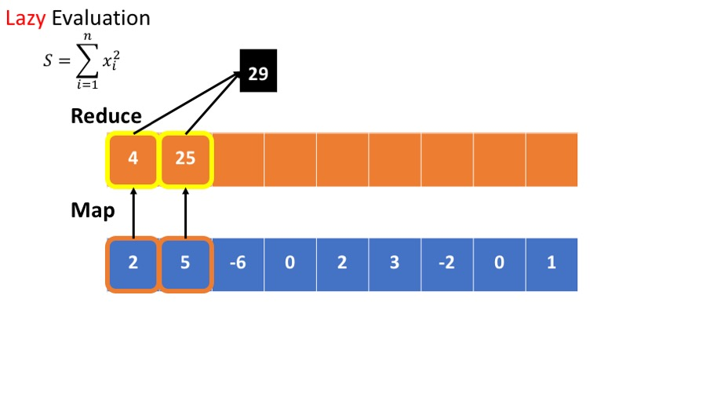
Example
Calculate

Slide 37
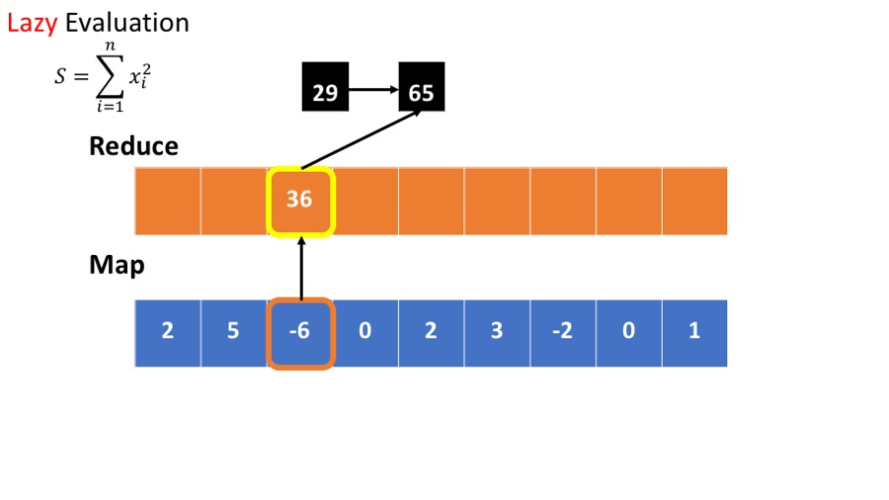
Example
Calculate

Slide 38
Spark Lazy evaluation
You have a text file of 1 GB and have created ten partitions of it.
You also performed some transformations, and in the end, you requested to see how the first line looks.
Spark will read the file only from the first partition and give you the results as your requested results do not require it to read the complete file.

Slide 39
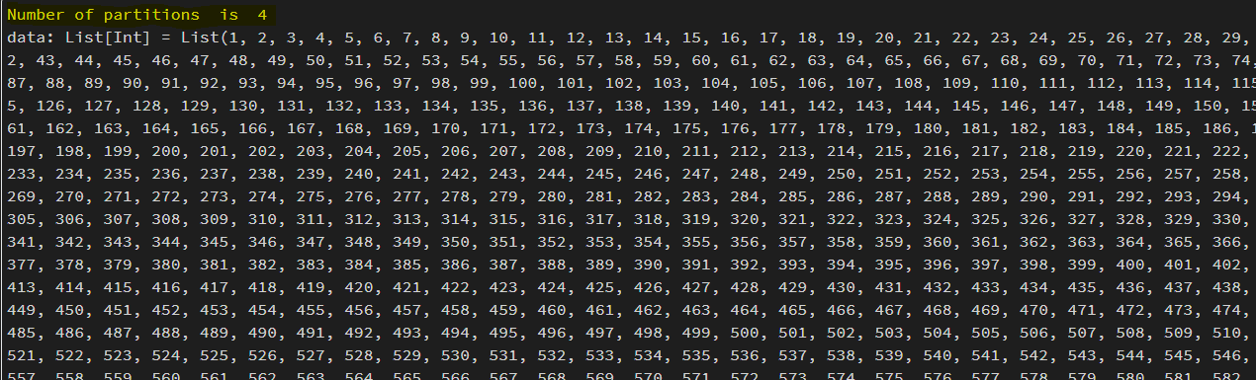
Example
In the first step, we created a list of 10 million numbers and made an RDD with four partitions below.
val data = (1 to 100000).toList
val rdd = sc.parallelize(data,4)
println("Number of partitions is "+rdd.getNumPartitions)

Slide 40
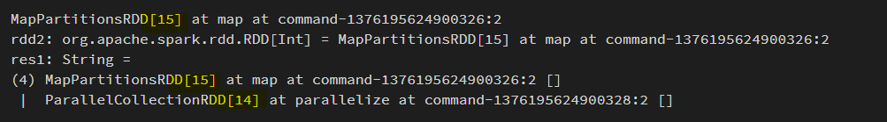
Example
perform a fundamental transformation, like adding 4 to each number
  ➔ It only records a series of transformations in the form of RDD Lineage
//Adding 5 to each value in rdd
val rdd2 = rdd.map(x => x+5)
println(rdd2)
//getting rdd lineage
rdd2.toDebugString

Slide 41
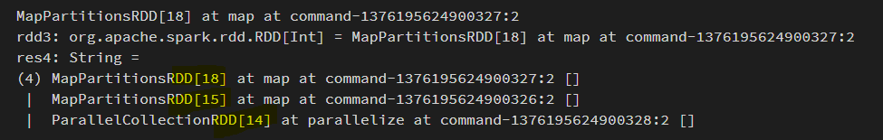
Example
adding 4 to each number
//Adding 5 to each value in rdd
val rdd3 = rdd2.map(x => x+20)
println(rdd3)
//getting rdd lineage
rdd3.toDebugString
rdd3.collect

Slide 42
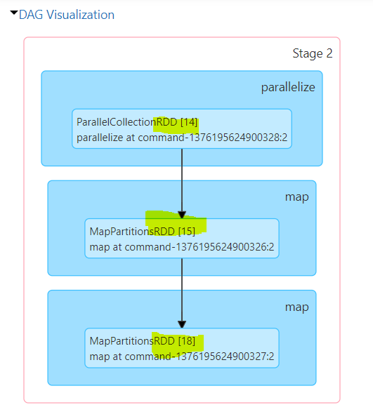

Slide 43
Example 2
import org.apache.spark.sql.functions._
val df1 = (1 to 100000).toList.toDF("col1")
//scenario 1
println("scenario 1")
df1.withColumn("col2",lit(2)).explain(true);
//scenario 2
println("scenario 2")
df1.withColumn("col2",lit(2)).drop("col2").explain(true);

Slide 44
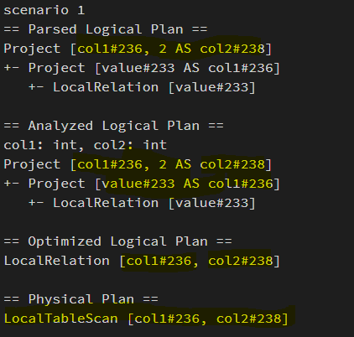
Example 2
import org.apache.spark.sql.functions._
val df1 = (1 to 100000).toList.toDF("col1")
//scenario 1
println("scenario 1")
df1.withColumn("col2",lit(2)).explain(true);
//scenario 2
println("scenario 2")
df1.withColumn("col2",lit(2)).drop("col2").explain(true);

Slide 45
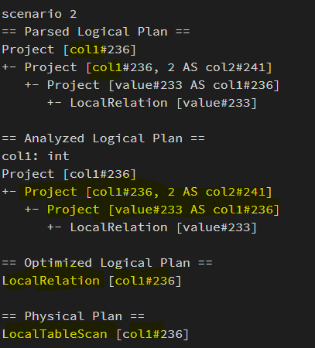
Example 2
import org.apache.spark.sql.functions._
val df1 = (1 to 100000).toList.toDF("col1")
//scenario 1
println("scenario 1")
df1.withColumn("col2",lit(2)).explain(true);
//scenario 2
println("scenario 2")
df1.withColumn("col2",lit(2)).drop("col2").explain(true);
there is no task of creation and of "col2"

Slide 46
Advantages of Spark Lazy Evaluation
Users can divide the entire work into smaller operations for easy readability and management
But, Spark internally groups the transformations reducing the number of passes on data
the action is triggered only when data is required
➔ only the necessary computation is done by Spark, which increases Speed.

Slide 47
Narrow Vs. Wide transformation
Narrow
Vs.
Wide
A,1
A,[1,2]
A,2
Map
groupByKey

Slide 48
Actions
What is an action
  The final stage of the workflow
  Triggers the execution of the DAG
  Returns the results to the driver
  Or writes the data to HDFS or to a file

Slide 49
Spark Workflow
FlatMap
Map
groupbyKey
Collect
Spark Context
Driver Program

Slide 50
Python RDD API Examples
Word count
  text_file = sc.textFile("hdfs://usr/godil/text/book.txt")
  counts = text_file.flatMap(lambda line: line.split(" ")) \
  .map(lambda word: (word, 1)) \
  .reduceByKey(lambda a, b: a + b)
  counts.saveAsTextFile("hdfs://usr/godil/output/wordCount.txt")
Logistic Regression
  # Every record of this DataFrame contains the label and
  # features represented by a vector.
  df = sqlContext.createDataFrame(data, ["label", "features"])
  # Set parameters for the algorithm.
  # Here, we limit the number of iterations to 10.
  lr = LogisticRegression(maxIter=10)
  # Fit the model to the data.
  model = lr.fit(df)
  # Given a dataset, predict each point's label, and show the results.
  model.transform(df).show()
Examples from http://spark.apache.org/

Slide 51
RDD Persistence and Removal
RDD Persistence
  RDD.persist()
  Storage level:
    MEMORY_ONLY, MEMORY_AND_DISK, MEMORY_ONLY_SER, DISK_ONLY,…….
RDD Removal
  RDD.unpersist()

Slide 52
Broadcast Variables and Accumulators
(Shared Variables )
Broadcast variables allow the programmer to keep a read-only variable cached on each node, rather than sending a copy of it with tasks
>broadcastV1 = sc.broadcast([1, 2, 3,4,5,6])
>broadcastV1.value
[1,2,3,4,5,6]
Accumulators are variables that are only “added” to through an associative operation and can be efficiently supported in parallel
accum = sc.accumulator(0)
accum.add(x)
accum.value

Slide 53
Spark’s Main Use Cases
Streaming Data
Machine Learning
Interactive Analysis
Data Warehousing
Batch Processing
Exploratory Data Analysis
Graph Data Analysis
Spatial (GIS) Data Analysis
And many more

Slide 54
My Spark Use Cases
Fingerprint Matching
  Developed a Spark based fingerprint minutia detection and fingerprint matching code
Twitter Sentiment Analysis
  Developed a Spark based Sentiment Analysis code for a Twitter dataset

Slide 55
Spark in the Real World (I)
Uber – the online taxi company gathers terabytes of event data from its mobile users every day.
  By using Kafka, Spark Streaming, and HDFS, to build a continuous ETL pipeline
  Convert raw unstructured event data into structured data as it is collected
  Uses it further for more complex analytics and optimization of operations
Pinterest – Uses a Spark ETL pipeline
  Leverages Spark Streaming to gain immediate insight into how users all over the world are engaging with Pins—in real time.
  Can make more relevant recommendations as people navigate the site
  Recommends related Pins
  Determine which products to buy, or destinations to visit

Slide 56
Spark in the Real World (II)
Here are Few other Real World Use Cases:
Conviva – 4 million video feeds per month
  This streaming video company is second only to YouTube.
  Uses Spark to reduce customer churn by optimizing video streams and managing live video traffic
  Maintains a consistently smooth, high quality viewing experience.
Capital One – is using Spark and data science algorithms to understand customers in a better way.
  Developing next generation of financial products and services
  Find attributes and patterns of increased probability for fraud
Netflix – leveraging Spark for insights of user viewing habits and then recommends movies to them.
  User data is also used for content creation

Slide 57
Spark: when not to use
Even though Spark is versatile, that doesn’t mean Spark’s in-memory capabilities are the best fit for all use cases:
  For many simple use cases Apache MapReduce and Hive might be a more appropriate choice
  Spark was not designed as a multi-user environment
  Spark users are required to know that memory they have is sufficient for a dataset
  Adding more users adds complications, since the users will have to coordinate memory usage to run code

Slide 58
HPC and Big Data Convergence
Clouds and supercomputers are collections of computers networked together in a datacenter
Clouds have different networking, I/O, CPU and cost trade-offs than supercomputers
Cloud workloads are data oriented vs. computation oriented and are less closely coupled than supercomputers
Principles of parallel computing same on both
Apache Hadoop and Spark vs. Open MPI

Slide 59
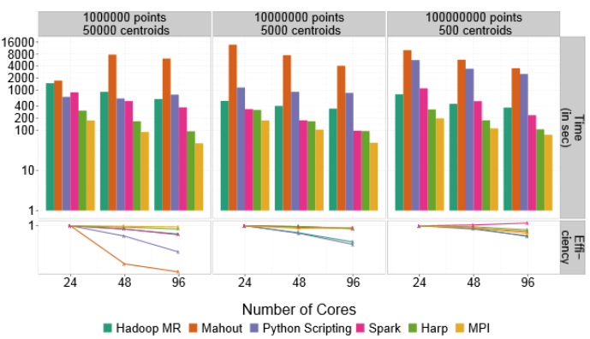
HPC and Big Data K-Means example
MPI definitely outpaces Hadoop, but can be boosted using a hybrid approach of other technologies that blend HPC and big data, including Spark and HARP. Dr. Geoffrey Fox, Indiana University. (http://arxiv.org/pdf/1403.1528.pdf)

Slide 60
Conclusion
Hadoop (HDFS, MapReduce)
  Provides an easy solution for processing of Big Data
  Brings a paradigm shift in programming distributed system
Spark
  Has extended MapReduce for in memory computations
  for streaming, interactive, iterative and machine learning tasks
Changing the World
  Made data processing cheaper and more efficient and scalable
  Is the foundation of many other tools and software

Slide 61
Backup

Slide 62
MapReduce vs. Spark for Large Scale Data Analysis
MapReduce and Spark are two very popular open source cluster computing frameworks for large scale data analytics
These frameworks hide the complexity of task parallelism and fault-tolerance, by exposing a simple programming API to users
Tasks | Word Count | sort | K-means | Page-Rank
MapReduce
Spark

